Slide 1

Granular and Relational SWOT Analysis: An Ontological Approach
Alican Tüzün

Slide 2
Why Rethink SWOT?

Slide 3
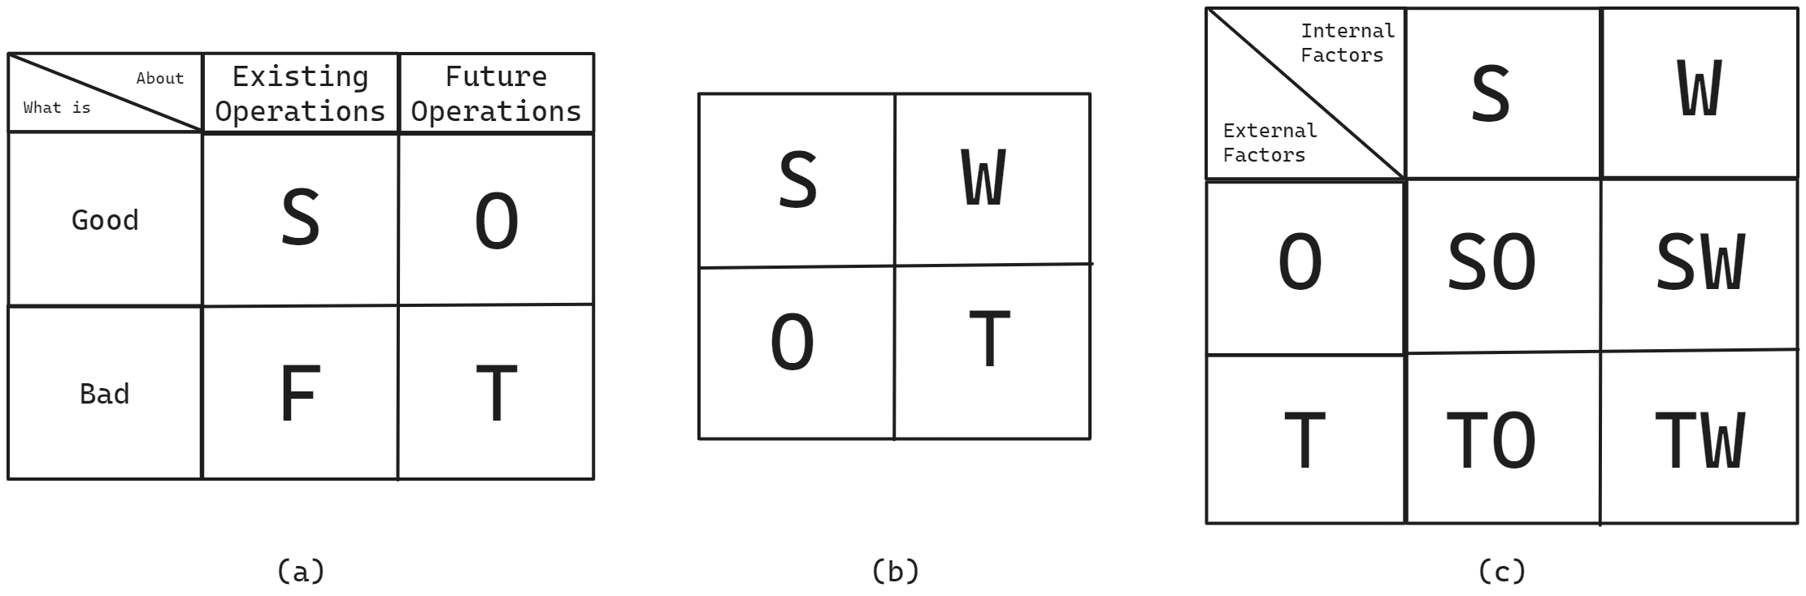
What is SWOT?
Notes:
Strategic decision-making is a complex process that relies on transforming raw data into actionable knowledge. To infer actionable knowledge, one widely utilized approach within strategic decision making process is SWOT analysis [37], which helps companies identify their strengths, weaknesses, opportunities, and threats, providing situational information [38].

Slide 4
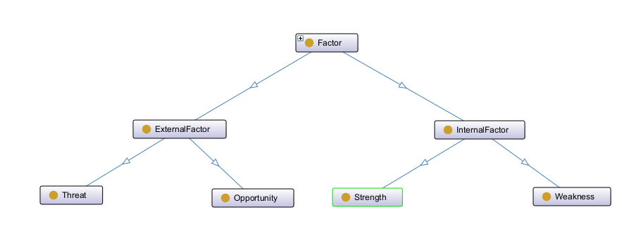
Why Rethink SWOT?
Notes:
I was generous here etc. , because the relationships were also not explicit. For example, it was not clear why the threat and opportunity were an external factor. However, here is defined as sub-class relationship, hence every threat is external factor or every strength is internal factor

Slide 5
Research Question and Aim

Slide 6
Research Question
How can SWOT attributes be classified into more granular subcategories and mapped through relationships to improve strategic knowledge extraction?

Slide 7
Aim
Enhance strategic analysis through granularity and relations.

Slide 8
Methodology

Slide 9
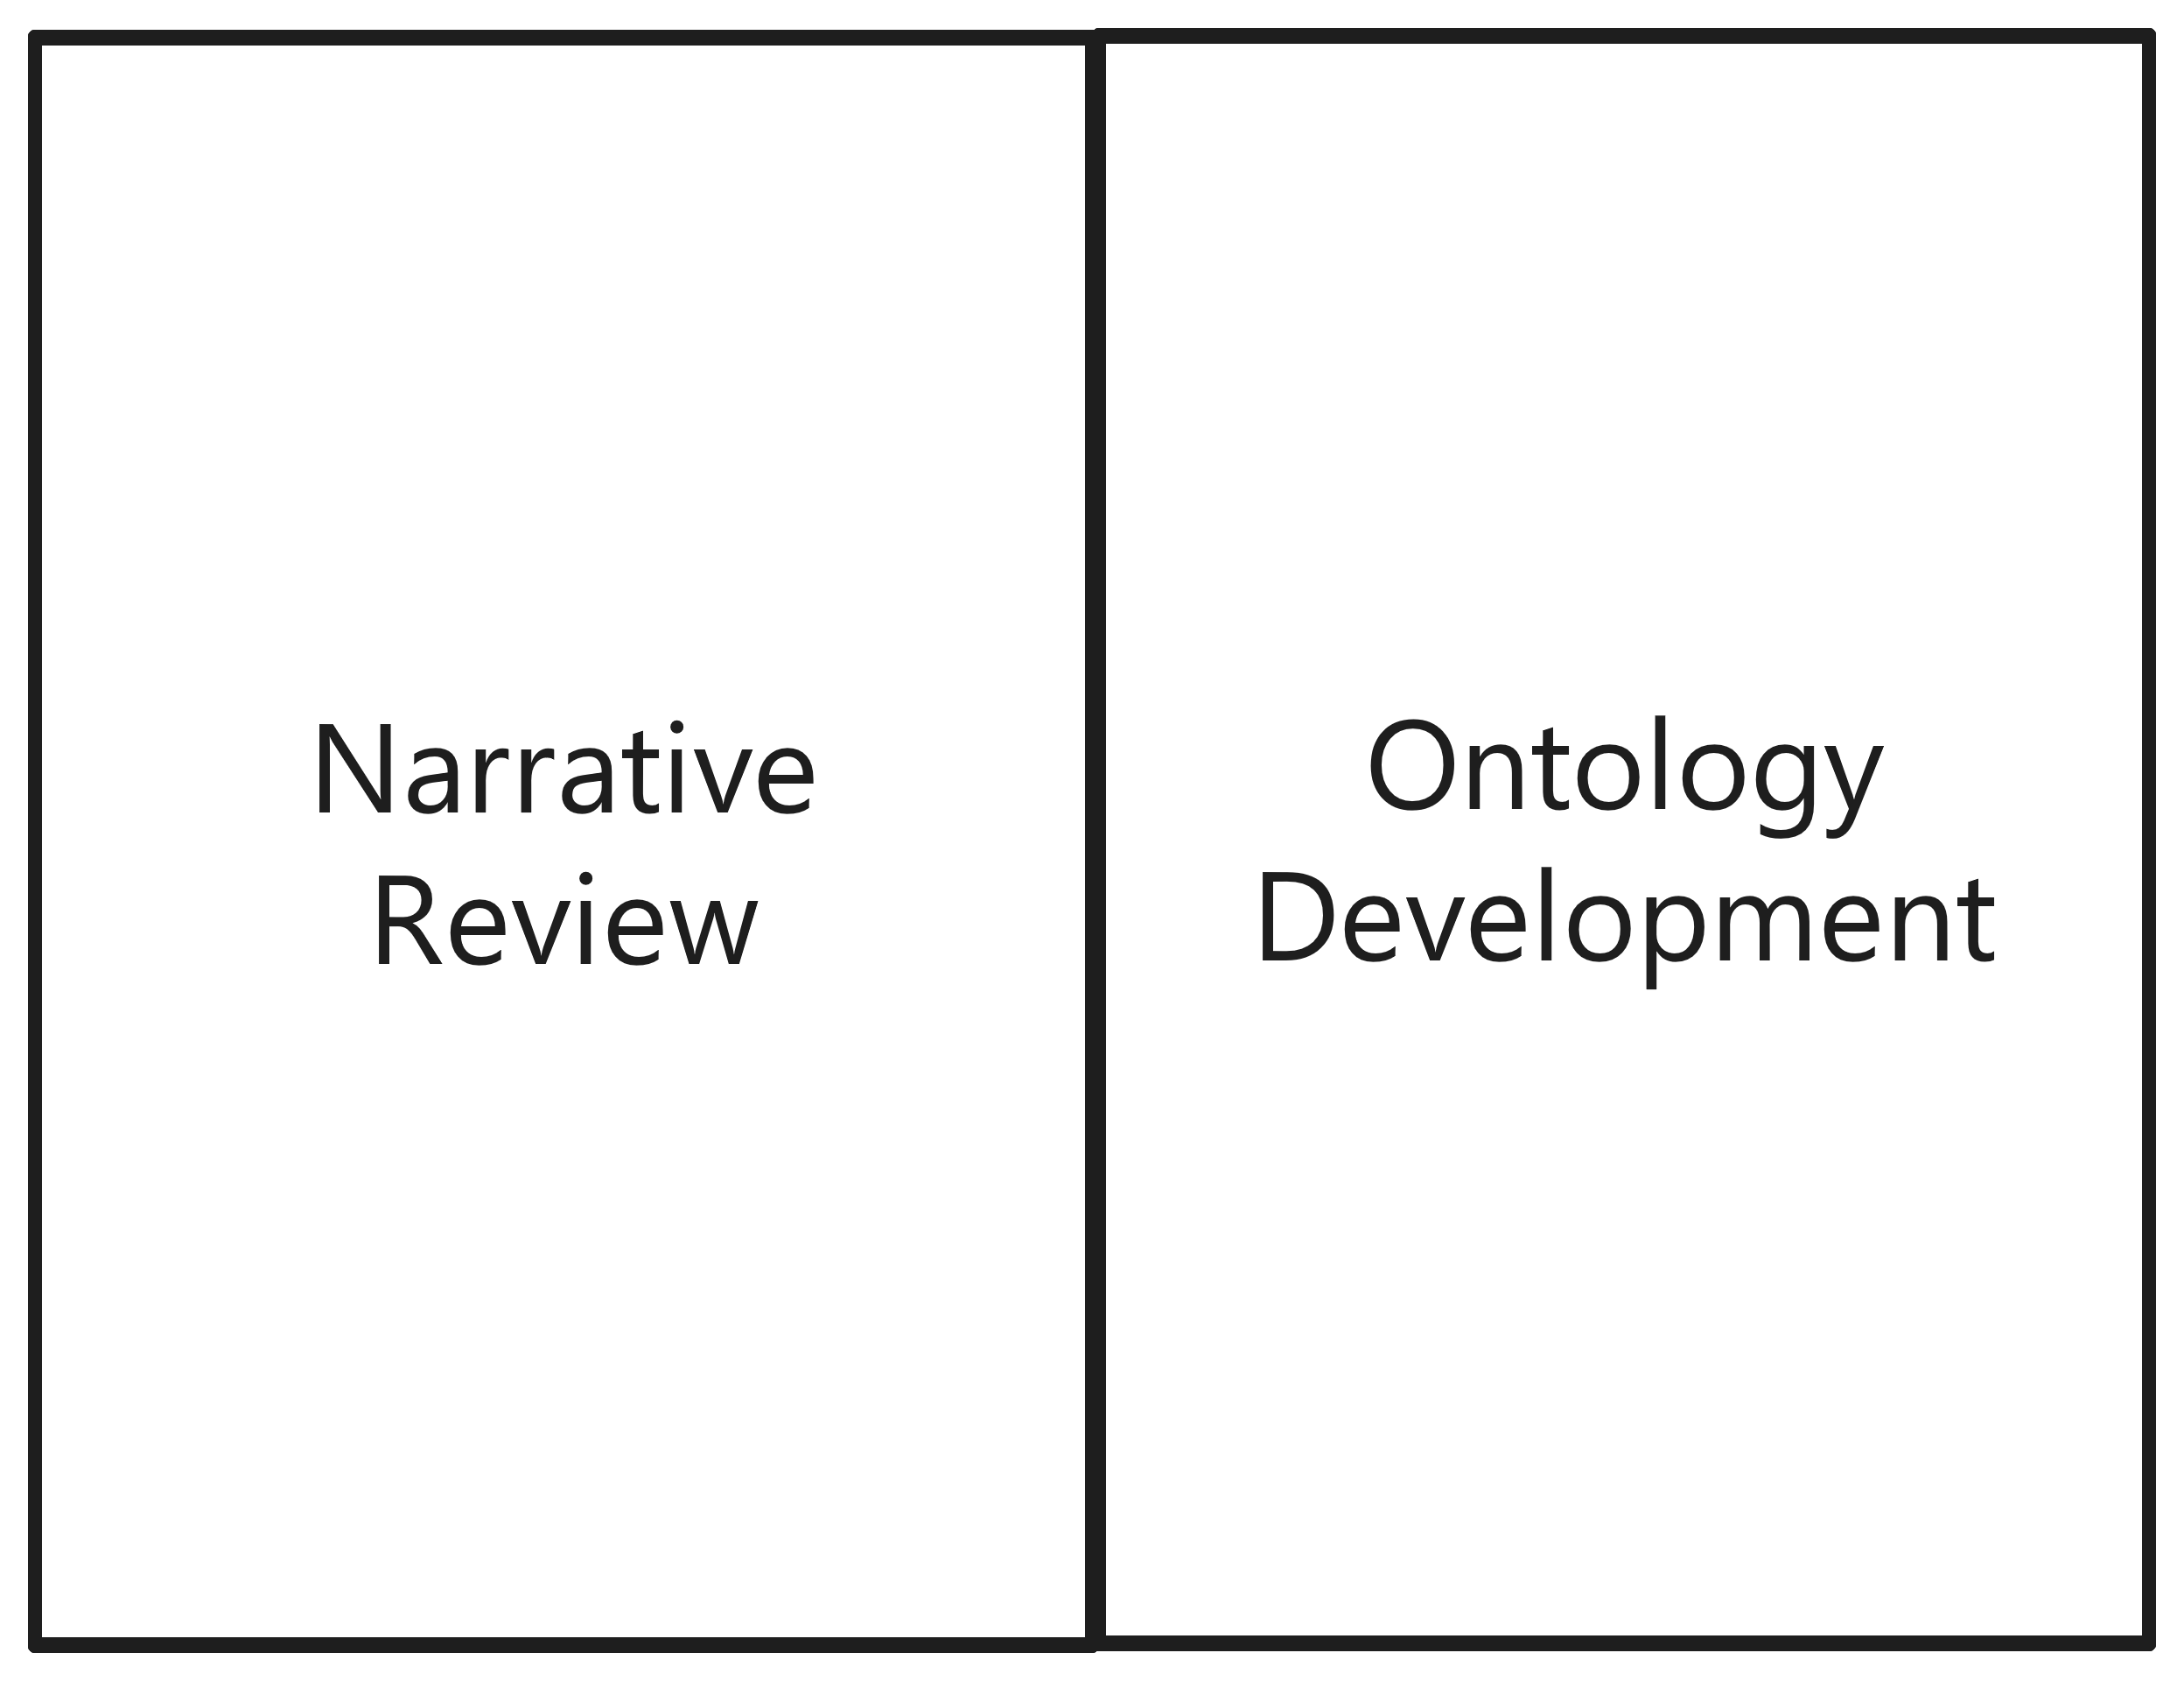
How we built the SWOTONT

Slide 10
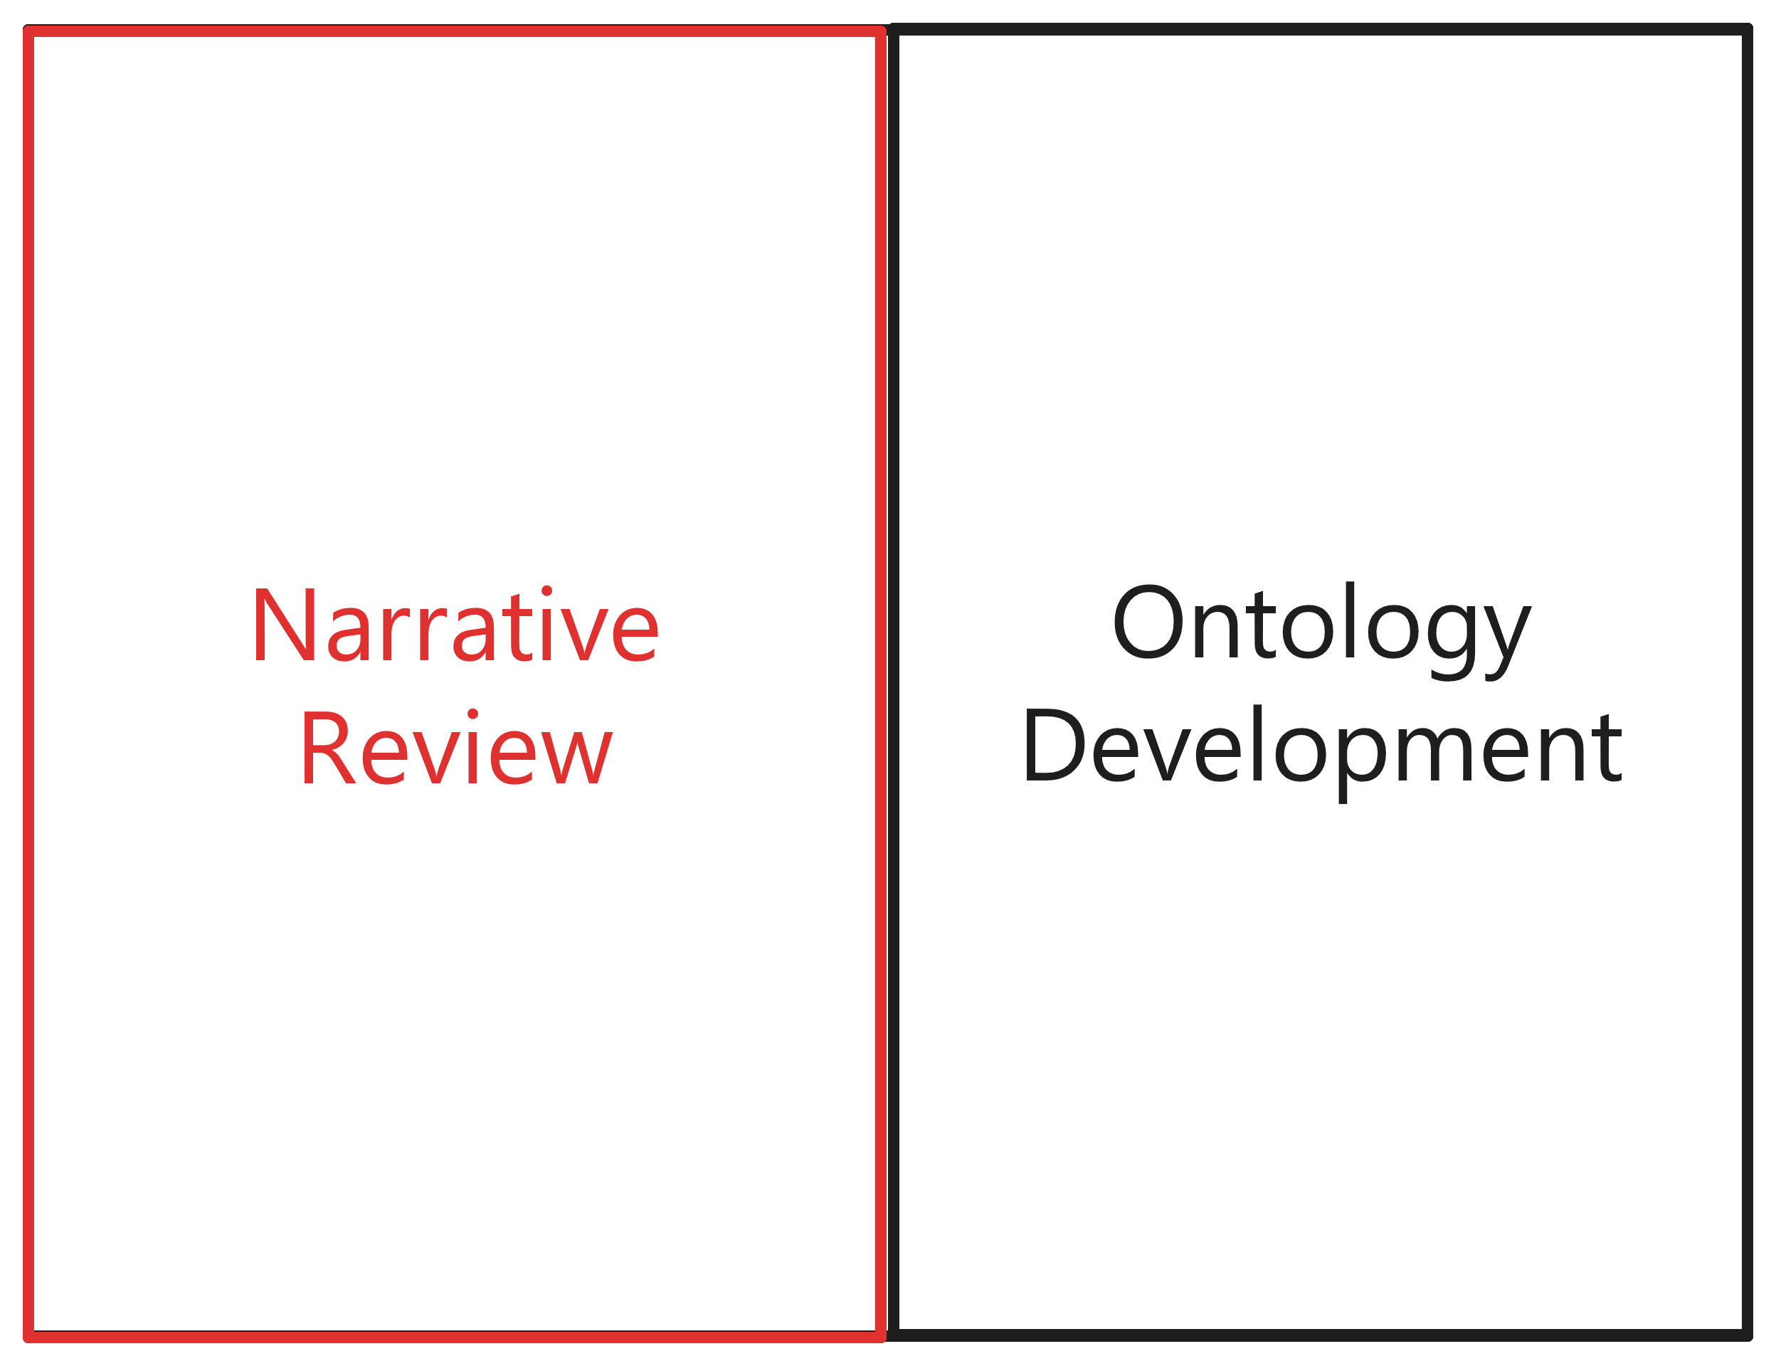
How we built the SWOTONT

Slide 11
Narrative Review
The research started with a specific article a historical review by Puyt et al.
Did backward and forward research to identify literature about the SWOT attributes and analysis.
We prioritized extension over specificity; hence, quality metrics such as SJR Q1-Q3 and VHB A, B, and C rankings were considered.
As sources, journal articles, conference papers, textbooks, and management articles (including narrative papers).

Slide 12
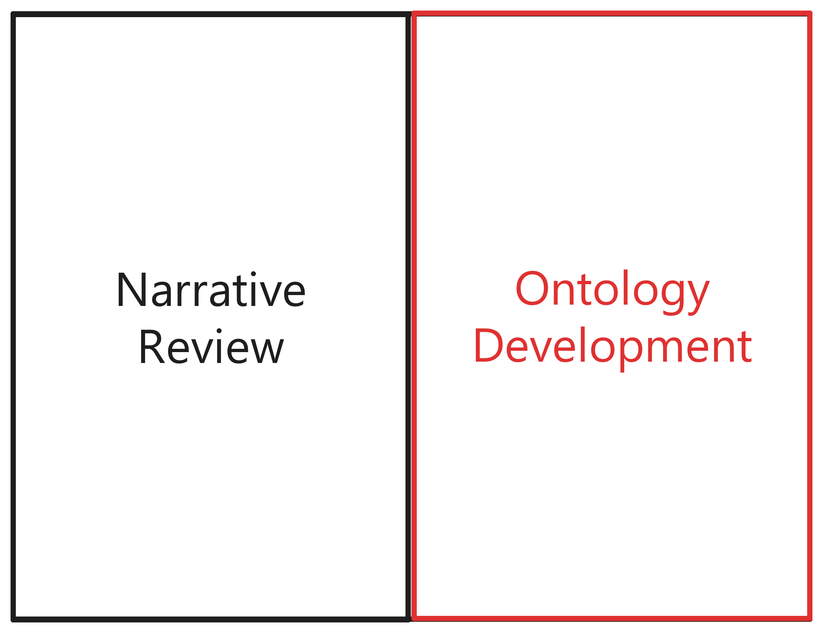
How we built the SWOTONT

Slide 13
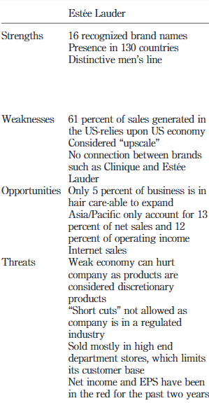
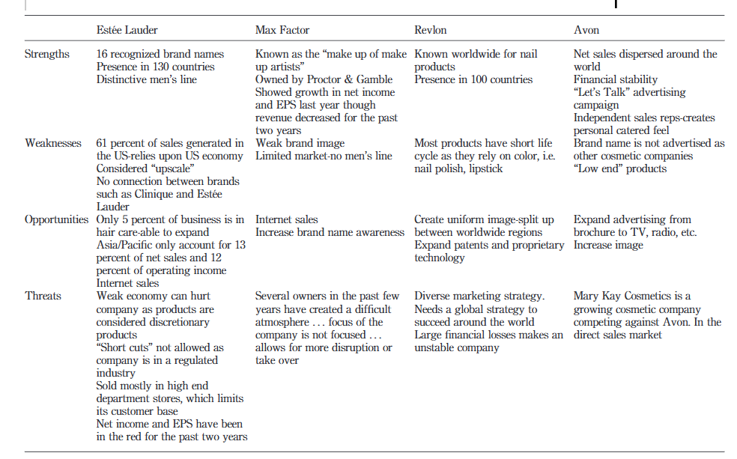
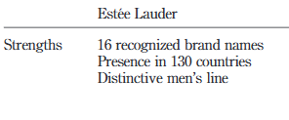
Ontology Development

Slide 14
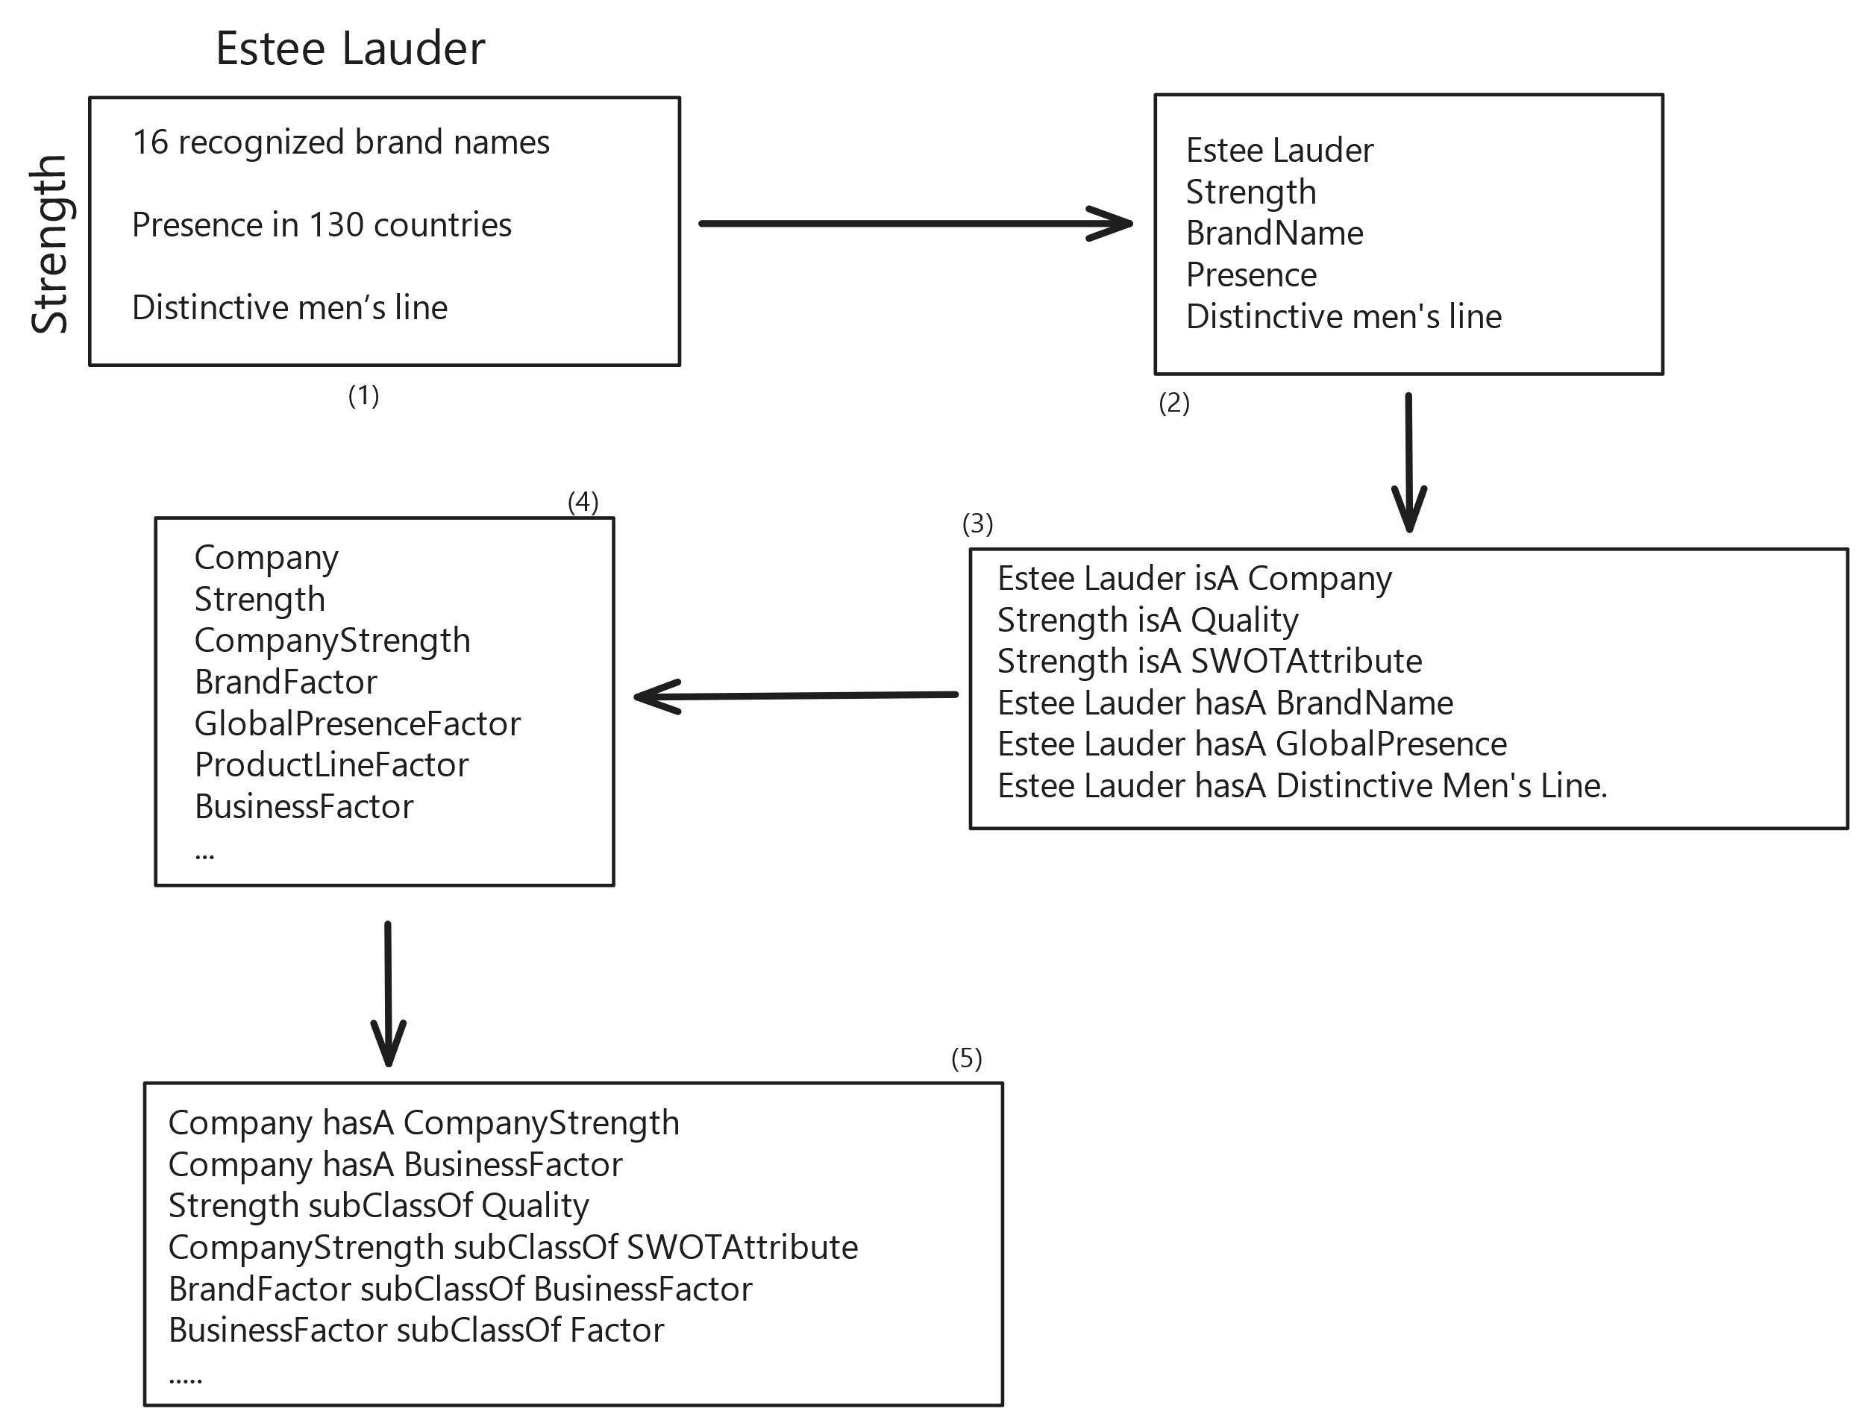
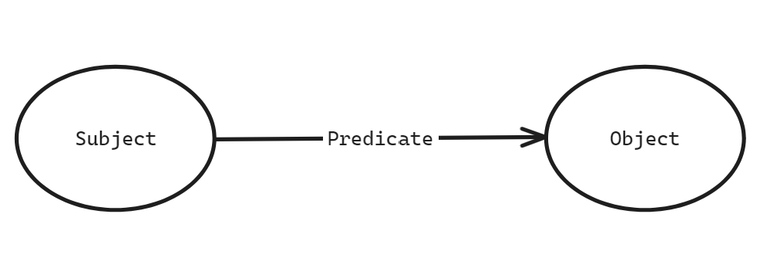
Ontology Development
Notes:
Third one, is KG fifth one is ontology
Also explain the difference, by philosophical sense metaphysics, ai sense concepts, or cs sense sets.

Slide 15
Result

Slide 16
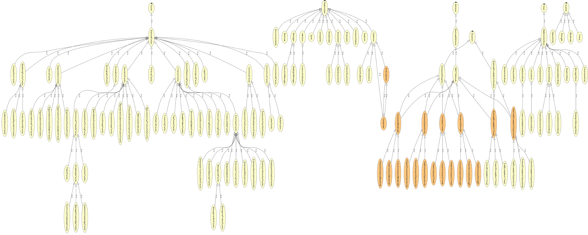
Ontology Development
Notes:
Available at Github

Slide 17
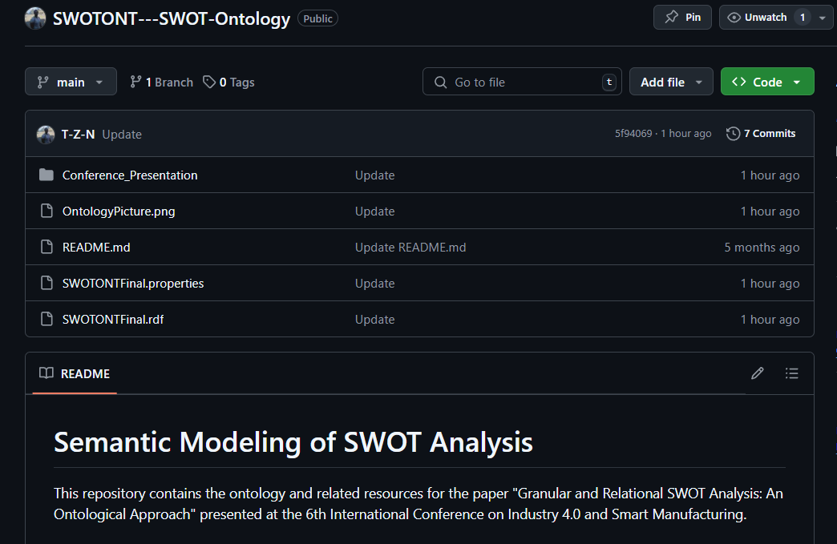
Ontology Development
Notes:
Available at Github

Slide 18
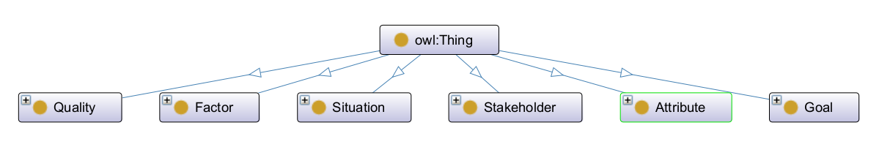
What is SWOTONT?
Notes:
Mention Quality and why you distinguished the Attributes as BusinessEcosystemAttribute and CompanyAttribute
Then mention the goal for context

Slide 19
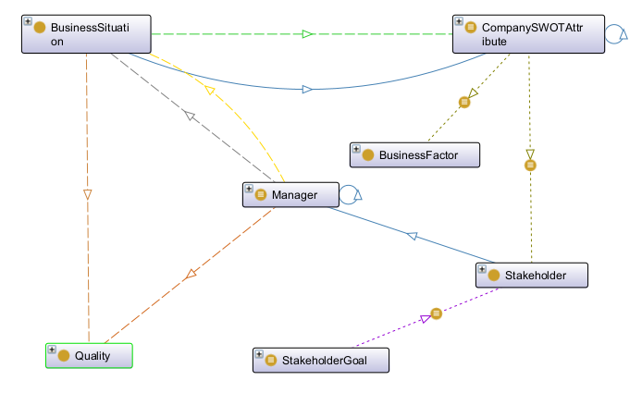
What is SWOTONT?
Notes:
The Factor class is a superclass that includes the 65 business factors identified in the literature. The object property hasImpact can be used to annotate business situations during data acquisition to derive a company’s SWOT attributes.
For each Stakeholder class member, the Goal Class includes the goals of the stakeholder. The object property
hasGoal, which serves as a link between the stakeholder and their goals, can be used to annotate the stakeholder’s
goals during data acquisition. Although members of this class do not have a direct impact on the inference, they do give the SWOT analysis process more meaning (semantics) through the interaction between the SWOT attribute and the stakeholder.
Situation is a superclass that includes the BusinessSituation class. Elements of this class correspond to the manager’s input, which is usually ambiguous and without context (e.g., Low Productivity) (See Figure 4 for example). There are two possibilities within the domain of SWOT. BusinessEcosystemSituation and CompanySituation. Former relates to the environmental or external situations, while former talks about the internal states of the company

Slide 20
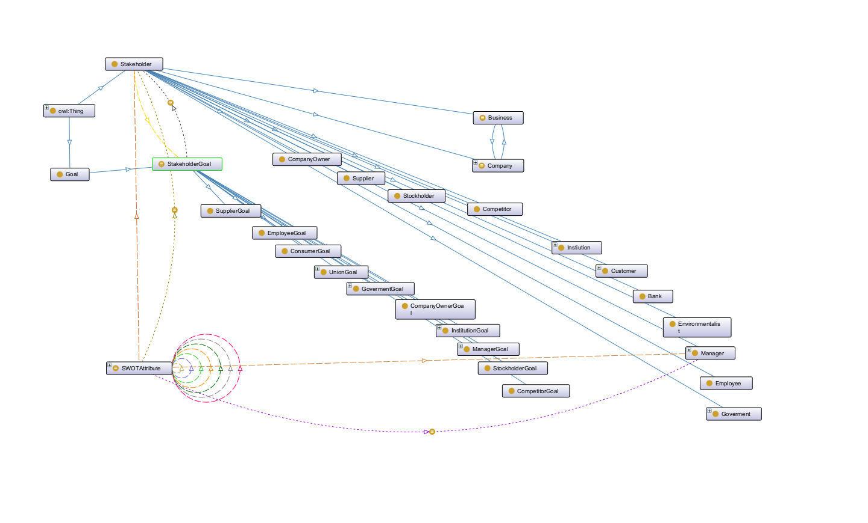
What is SWOTONT?
Notes:
The Factor class is a superclass that includes the 65 business factors identified in the literature. The object property hasImpact can be used to annotate business situations during data acquisition to derive a company’s SWOT attributes.
For each Stakeholder class member, the Goal Class includes the goals of the stakeholder. The object property
hasGoal, which serves as a link between the stakeholder and their goals, can be used to annotate the stakeholder’s
goals during data acquisition. Although members of this class do not have a direct impact on the inference, they do give the SWOT analysis process more meaning (semantics) through the interaction between the SWOT attribute and the stakeholder.
Situation is a superclass that includes the BusinessSituation class. Elements of this class correspond to the manager’s input, which is usually ambiguous and without context (e.g., Low Productivity) (See Figure 4 for example). There are two possibilities within the domain of SWOT. BusinessEcosystemSituation and CompanySituation. Former relates to the environmental or external situations, while former talks about the internal states of the company

Slide 21
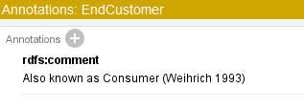
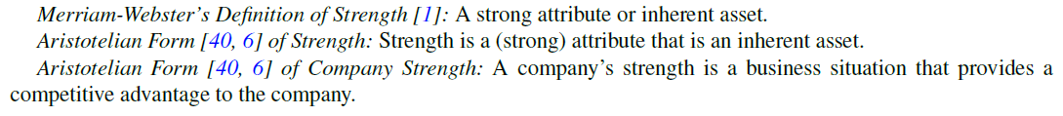
Ontology Development
Notes:
Available at Github

Slide 22
Why is SWOTONT Significant?
Notes:
Problem to derive actionable insights

Slide 23
Future Work

Slide 24
Where Do We Go From Here?

Slide 25
Questions?

